Slide 1
Resistors in Series
Consider a circuit with multiple resistors connected in series.
Find their “equivalent resistance”.
KCL tells us that the same current (I) flows through every resistor
KVL tells us
I
R₁
R₂
V_{SS}
+
−
R₃
R₄
Equivalent resistance of resistors in series is the sum
of the individual resistances
EE 42 and 100, Fall 2005
Week 1

Slide 2
Voltage Divider
I = V_{SS} / (R₁ + R₂ + R₃ + R₄)
I
+
–
R₁
V₁
R₂
V_{SS}
+
+
–
−
R₃
V₃
R₄
EE 42 and 100, Fall 2005
Week 1

Slide 3
When can the Voltage Divider Formula be Used?
I
I
R₁
R₁
+
–
+
–
R₂
V₂
R₂
V₂
V_{SS}
+
V_{SS}
+
−
R₃
−
R₃
R₄
R₄
R₅
R
R
V
2
⋅
V
V
2
⋅
V
2
=
SS
2
≠
SS
R
+
R
+
R
+
R
R
+
R
+
R
+
R
1
2
3
4
1
2
3
4
Correct, if nothing else
is connected to nodes
because R₅ removes condition
of resistors in series
EE 42 and 100, Fall 2005
Week 1

Slide 4
Resistors in Parallel
Consider a circuit with two resistors connected in parallel.
Find their “equivalent resistance”.
x
KVL tells us that the
same voltage is dropped
across each resistor
  V_{x} = I₁ R₁ = I₂ R₂
KCL tells us
I₁
I₂
I_{SS}
R₁
R₂
EE 42 and 100, Fall 2005
Week 1

Slide 5
General Formula for Parallel Resistors
What single resistance R_{eq} is equivalent to three resistors in parallel?
I
I
+
+
V
R₁
R₂
R₃
eq
≡
V
R_{eq}
−
−
Equivalent conductance of resistors in parallel is the sum
EE 42 and 100, Fall 2005
Week 1

Slide 6
Current Divider
x
I₁
I₂
I_{SS}
R₁
R₂
V_{x} = I₁ R₁ = I_{SS} R_{eq}
EE 42 and 100, Fall 2005
Week 1

Slide 7
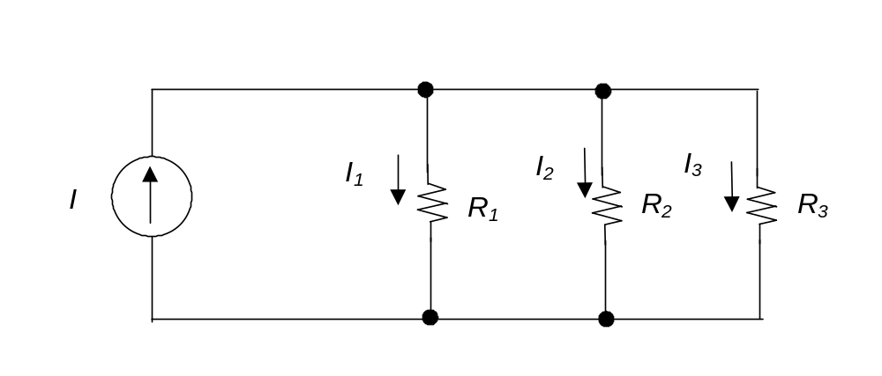
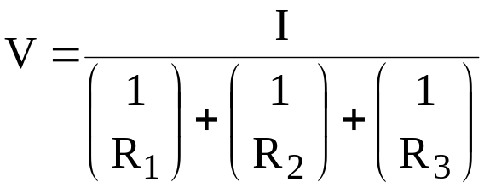
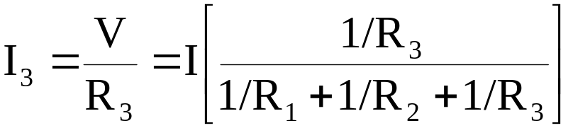
Generalized Current Divider Formula
Consider a current divider circuit with >2 resistors in parallel:
+
V
−
EE 42 and 100, Fall 2005
Week 1

